Slide 1
R CLINIC
Session 2: Data Exploration

Slide 2
Don't forget to write down your email address!

Slide 3
Getting to know your data…
Prior to analysis
Basic statistical summaries
Exploratory graphs
Make informed decisions on subsequent analyses

Slide 4


Iris dataset
Open new R script in Rstudio
Load library ‘datasets’ and iris data
Use head() and tail() functions
dim(iris) gives dimensions of dataset

Slide 5
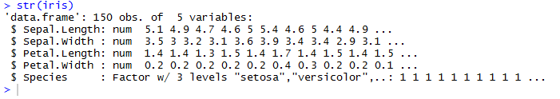
Structure and classes
Inspect structure of dataset
Many different classes of data e.g. numeric, factor
Different classes combined in dataframe

Slide 6
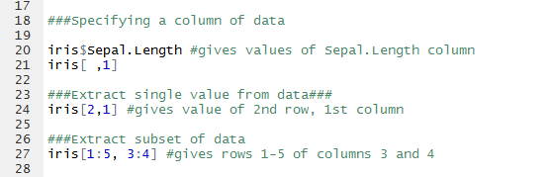
Specifying a subset or column
Can use names or index to specify data

Slide 7

Factors have levels

Slide 8

Basic summary statistics
Try max(), min(), range() and mean() on a column of data
E.g.
Remember ?function.name will bring up the help file for the function e.g. ?mean
What is the range of petal widths?

Slide 9
Let’s visualise the data….
R can produce publication quality graphics
Simple graphics are good way of getting to grips with the data
They can inform decisions about analyses e.g. error families (we’ll talk about these at a later data)

Slide 10

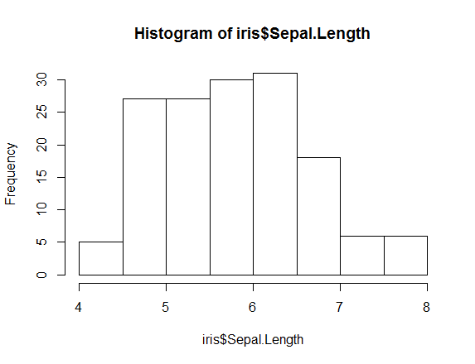
Histogram

Slide 11

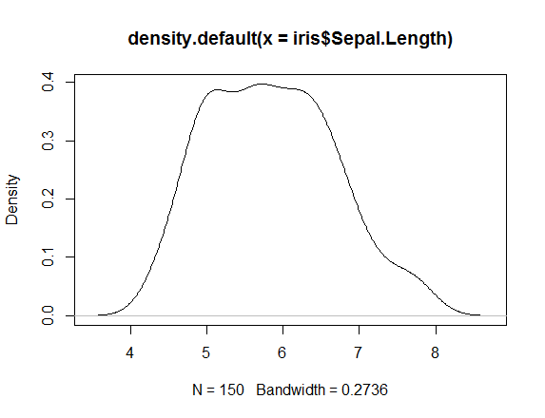
Density plot

Slide 12

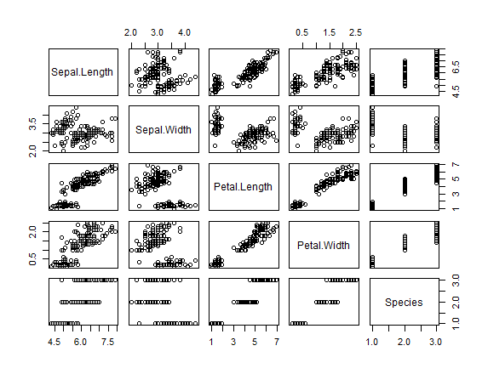
Pair plot
Can use this to look
for collinearity
between variables

Slide 13

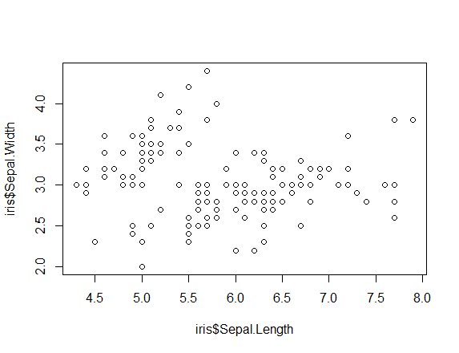
Scatter plot of continuous variables
How does petal
width vary with
petal length?

Slide 14

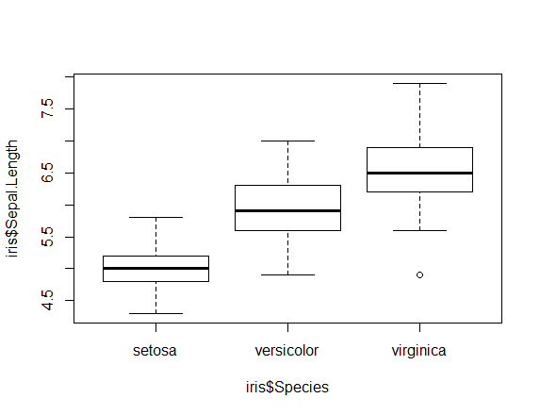
Box plot
~ can be read as ‘as a function of’

Slide 15
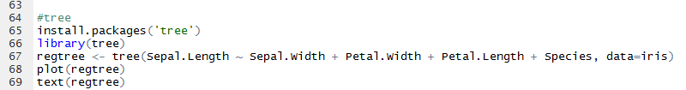
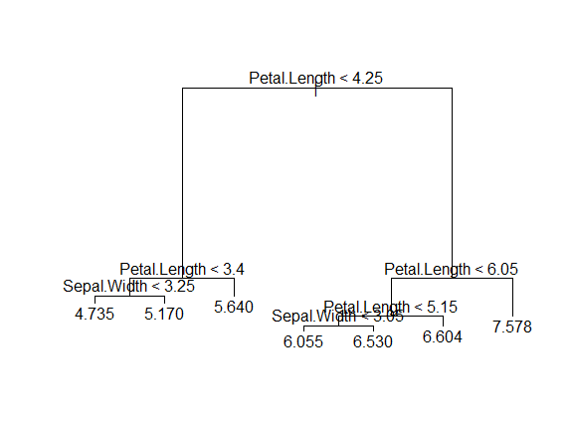
Tree

Slide 16
Summary
Remember row first, column second
Use dim(), str() etc. to look at structure of data
Basic summary statistics e.g. mean()
Graphs can help inform later analyses e.g. hist()

Slide 17
Next time...Data Manipulation
subsets
summing across rows and columns
binding rows and columns
extracting specific levels of a factor
ordering data
merging data frames

Slide 18
ChallengeR
Install package 'datasets' and load a dataset e.g. mtcars
Get summary statistics
Produce summary plots

